Slide 1
Detect Gasses produced by waste-Burning

Slide 2
Detect Gasses Produced by Waste Burning
Problem Statement
1.1. Smog
1.2. Harmful gasses
Unit 2. Methodology
2.1. Data collection
2.2. Collect dangerous gasses
2.3. Visualization and heat map
Unit 3. Result
3.1. CO
3.2. CH4
3.3. SO2
3.4. NO2

Slide 3

Problem Statement
1.1
Problem Statement
UNIT
01
1.1. Smog:
Smog has become a severe environmental and public health challenge in Pakistan, particularly in cities like Lahore, due to waste-burning activities that release harmful gases like methane (CH4) and nitrogen oxides (NO2). The lack of effective tools to identify and analyze these pollution hotspots has hindered efforts to mitigate their impact. This project aims to provide a geospatial and data-driven solution to detect waste-burning locations, visualize gas concentrations, and identify high-smog zones, enabling targeted strategies to reduce pollution and improve air quality.
1.2. Harmful Gasses
The burning of waste releases harmful gases like CO, SO₂, NOₓ, and VOCs, contributing to air pollution, smog, and health risks such as respiratory and cardiovascular diseases. These emissions degrade air quality and harm the environment, highlighting the need for intelligent systems to detect and classify these gases for effective pollution control and environmental protection.
Detect Gasses produced by waste-burning

Slide 4
Methodology
2
Methodology
01
2.1. Data Collection
Collecting accurate data on gases emitted from waste burning is challenging due to varying environmental conditions, limited monitoring systems, and inconsistent reporting. Reliable data is crucial for developing effective models to classify harmful gases and address their environmental and health impacts.
2.2. Collect dangerous gasses
Collecting data on harmful gases from waste burning through Google Earth Engine offers a scalable approach but faces challenges like data resolution, variability in atmospheric conditions, and identifying localized emissions. Accurate extraction and analysis of satellite-derived datasets are essential for detecting and classifying pollutants to address environmental and health impacts effectively.
2.3. Visualization and heat map
Visualization and heatmaps in QGIS play a crucial role in analyzing spatial patterns of gas emissions from waste burning. By mapping emission hotspots, these tools provide a clear and intuitive way to identify areas with severe pollution levels, enabling targeted interventions and effective environmental management strategies.
Detect Gasses produced by waste-burning

Slide 5
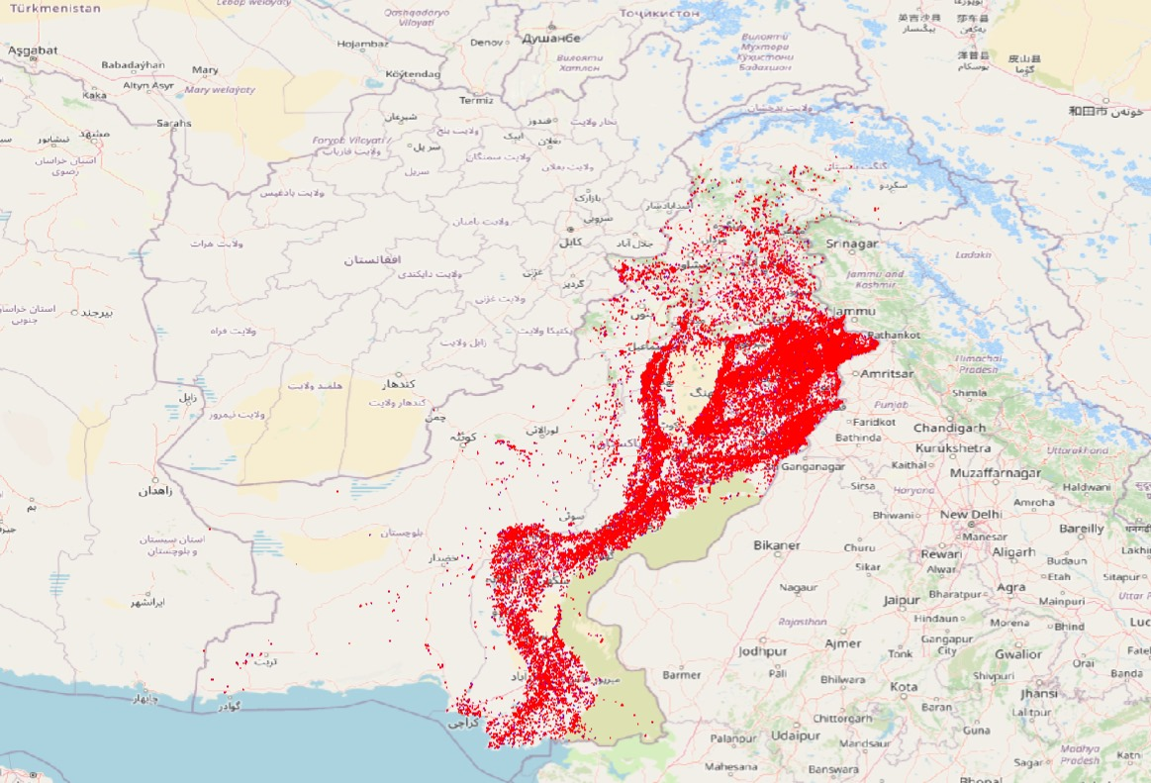
Result
3
Result
03
3.1. Carbon Monoxide (CO)
Detect Gasses produced by waste-burning

Slide 6
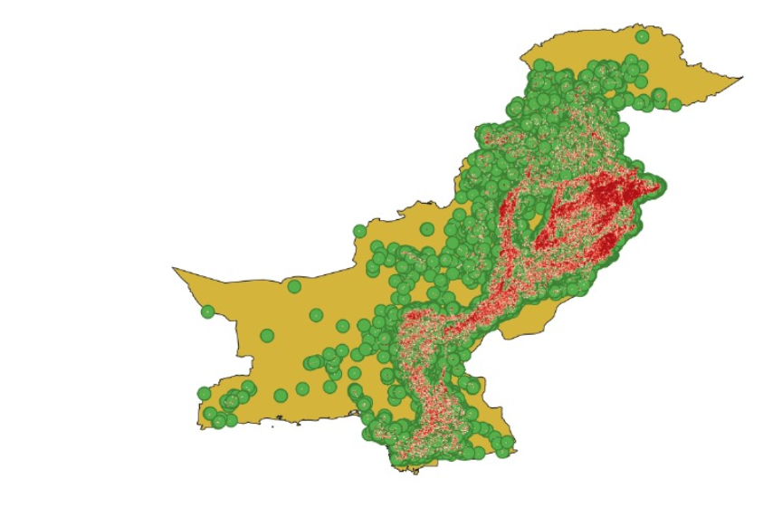
03
Result
03
3.2. Methane (CH4)
Detect Gasses produced by waste-burning

Slide 7
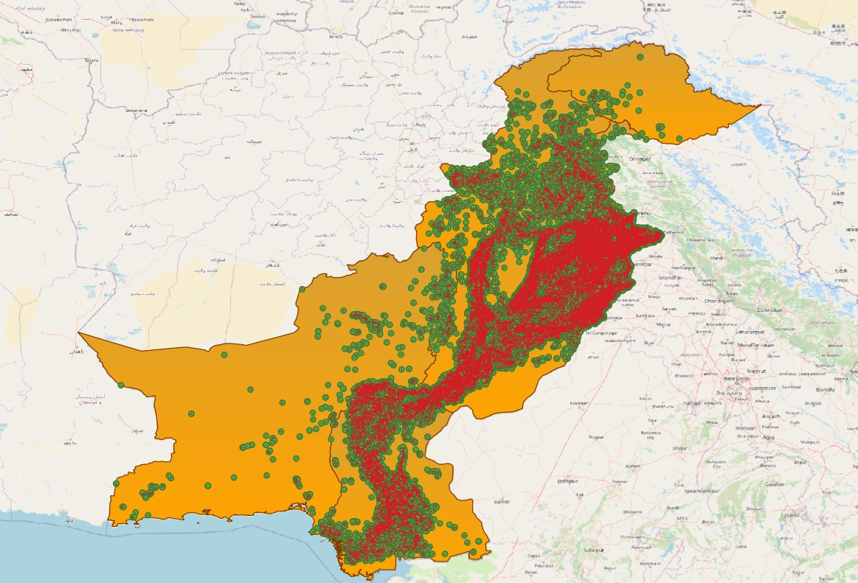
03
Result
03
3.3. Sulphur Dioxide (SO2)
Detect Gasses produced by waste-burning

Slide 8
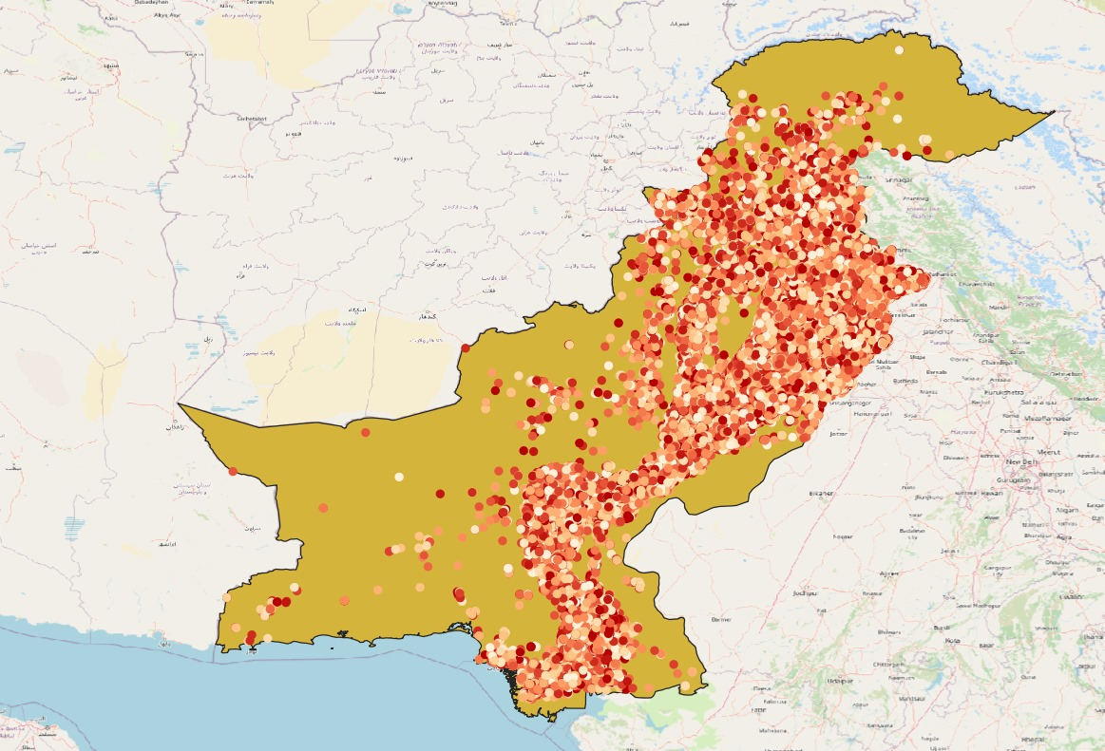
03
Result
03
3.4. Nitrogen Dioxide (NO2)
Detect Gasses produced by waste-burning

